Slide 1
Adding attributes to classes
COMP 3931
Larman: Chapter 9
W4L2 Adding Attributes
COMP 3931 OOA&D

Slide 2
Attributes
An attribute is a logical data value of an object
Include attributes for which the requirements (example: use cases) suggest or imply a need to remember information
  Example: a receipt (which represents information of a sale) includes date and time which management needs to know about for a variety of reasons.
Data value held by object
Collectively store the state of the object

Slide 3
UML attribute Notation
Receipt
date : Date
time : Time
Attributes
Attributes are shown in the second compartment of the class box
Their type may be optionally shown

Slide 4
Attribute types in conceptual model
The type of an attribute should NOT normally be a complex domain concept such as a Sale or Airport.
Attributes should be preferably be simple attributes or data types.
  Example:
    Boolean, Date, Number, String (Text), Time, etc…
  Other common types include:
    Address, Color, PhoneNumber, SocialSecurityNumber, UniversalProductCode (UPC), PostalCode, etc….

Slide 5
Attribute verses Association (conceptual)
Avoid representing complex domain concepts as attributes – use associations instead
  The most useful way to express that a cashier uses a Register is with an association, not with an attribute.
Cashier
Worse
not a "simple" attribute
name
currentRegister
Cashier
Uses
Register
Better
1
1
name
number

Slide 6
Conceptual Modeling verses Programming
In the modeling domain:
  an attribute cannot be an instance of another object
  situation is modeled as a relationship between classes or objects ("has a" relationship)
In the programming domain data members are often objects.
  Decision should be deferred during domain modeling

Slide 7
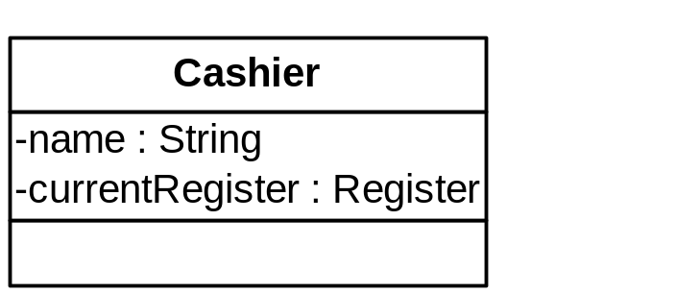
What about attributes in code?
During the design and implementation work, associations between objects will often be implemented as attributes that reference other complex software objects
Conceptual Model
Cashier
Uses
Register
1
1
name
number
Implementation (programming)

Slide 8
Non-primitive data type classes
Represent what may initially be considered a primitive data type as a class under the following situations:
Situation | Example
It is composed of separate sections | Phone number, name of person
There are operations usually associated with it, such as parsing or validation. | Social security number
It has other attributes | Promotional price could have a start date and end date
It is a quantity with a unit | Payment amount has a unit of currency
It is an abstraction of one or more types with some of these qualities. | UPC (Universal Product Code) or EAN (European Article Number). These numeric coding schemes have subparts identifying the manufacturer, product, country, and a check-sum for validation.

Slide 9
Data type classes in POS domain
Based on previous slide, following are good candidates for non-primitive classes:
  Item identifier
  Price and amount
  Address
Whether or not these are shown as separate conceptual classes really depends on what the analyst wishes to emphasize in a domain model.
  may be shown either as an attribute or a conceptual class
  No correct answer – all depends on how the domain model is being used as a communication tool

Slide 10
Data type classes in POS domain
Domain Model
Product
1
1
ItemID
Store
1
1
Address
Specification
Product
Store
Specification
address : Address
id : ItemID
Design Model

Slide 11
Design Creep
Attributes should not be used to relate conceptual classes as in the design model
  Do not add a kind of foreign key attribute in order to associate two types, as is typical in relational database design.

Slide 12
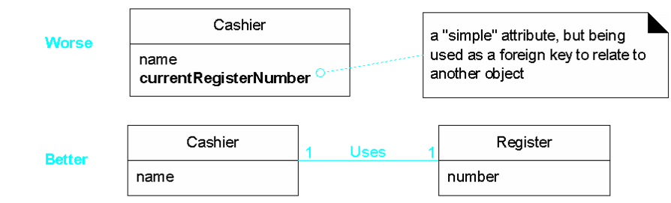
  In the example below, the currentRegisterNumber in Cashier class undesirable because its purpose is to relate the Cashier and Register objects. Better use association.

Slide 13
Modeling attribute Quantities & Unit
Most numeric quantities should not be represented as plain numbers.
  Example: Speed required knowledge of unit (I.E. Kilometers/Hr or Meters/Sec or Miles/Hr …)
Payment
not useful
amount : Number
Payment
Has-amount

Quantity
Is-in

Unit
*
1
amount : Number
*
1
...
Payment
quantities are pure data
amount : Quantity
values, so suitable to show in
better
attribute section
Payment
variation:
Money
is a
specialized
Quantity
whose
amount : Money
unit is a currency

Slide 14
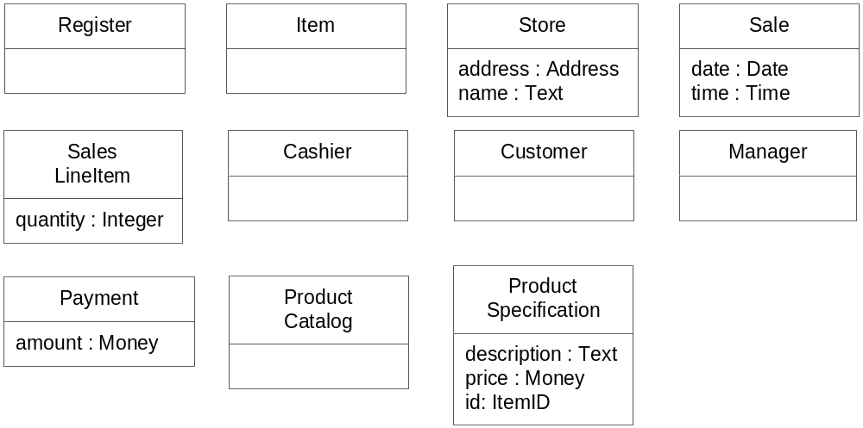
Case Study: POS Model
Attributes for the POS Domain Model

Slide 15
Questions and Conclusions
W4L2 Adding Attributes
COMP 3931 OOA&D

